Slide 1
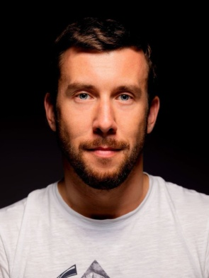
Специализированные технологии машинного обучения/ Advanced Machine learning Technologies
Peter Gladilin
PhD
Associate Professor in ITMO University
Senior R&D Engineer in Huawei
8 lectures + 12 labs (practice) → (10+10)
Thursday 19-00 (lecture) + 20-30 (practice)
Exam (Date - TBA) - for all groups + Course Project (separate mark)
4 passed lab tasks as your permission to the exam
“4C” automatically if you have all 4 tasks in time (deadline is to be announced)
Telegram group: t.me/amlt_2024

Slide 2
Plan of the course:
Time Series analysis and prediction – task #1
Reinforcement Learning (RL)
Interpretable Machine Learning – task #2
GANs and VAEs – task #3
Modern Image & Video Signal processing
Quality Assessment in Deep Learning – task #4
Attention and Transformers
Mobile and Tiny AI. DL Deployment.

